Slide 1
Design Pattern
Course Level – Intermediate

Slide 2
About the Course Creators
Course Name | Design Pattern
Course Author Name : | Thavasi Narayanan S & Logeshwaran M
About the Author : | Senior Software Engineer & Sr. Tech. Trainer
Date of Creation | 14-Jan-2024

Slide 3
After completing this course, the participants will be able:
to understand what is Design Pattern.
to understand how to write a C# program with Design Pattern.
Course Learning Objectives

Slide 4
What is Design Pattern?
How to define and use the Design Pattern in C#.Net?
Do You Know?

Slide 5
Pre-Test
S.No | Question | Answer Options
1 | How many types of design patterns are there? | A) 3 B) 5 C) 8 D) 10
2 | Which of the following is NOT a creational design pattern? | A) Singleton Pattern B) Factory Pattern C) Bridge Pattern D) Prototype Pattern

Slide 6
Pre-Test
S.No | Question | Answer Options
3 | Which of the following is a behavioral design pattern? | A) Observer Pattern B) Composite Pattern C) Flyweight Pattern D) Builder Pattern
4 | Which pattern helps in reducing complex conditional logic? | A) Strategy pattern B) Observer pattern C) Factory pattern D) Proxy pattern

Slide 7
Design Pattern

Slide 8

Design patterns represent the best practices used by experienced object-oriented software developers.
Design patterns are solutions to general problems that software developers faced during software development.
These solutions were obtained by trial and error by numerous software developers over quite a substantial period of time.
Design Pattern
Design Patterns in the object-oriented world are a reusable solution to common software design problems that repeatedly occur in real-world application development.
It is a template or description of how to solve problems that can be used in many situations.

Slide 9
In 1994, four authors Erich Gamma, Richard Helm, Ralph Johnson and John Vlissides published a book titled Design Patterns - Elements of Reusable Object-Oriented Software which initiated the concept of Design Pattern in Software development.
These authors are collectively known as Gang of Four (GOF). According to these authors design patterns are primarily based on the following principles of object oriented design.
Program to an interface not an implementation
Favor object composition over inheritance
What is Gang of Four (GOF)?

Slide 10
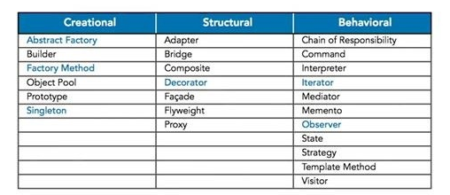
There are 23 design patterns which can be classified in three categories:
Creational patterns
Structural patterns and
Behavioral patterns.
Types of Design Patterns

Slide 11
Design Patterns have two main usages in software development.
Common platform for developers
Design patterns provide a standard terminology and are specific to particular scenario. For example, a singleton design pattern signifies use of single object so all developers familiar with single design pattern will make use of single object.
Best Practices
Design patterns have been evolved over a long period of time and they provide best solutions to certain problems faced during software development.
Learning these patterns helps inexperienced developers to learn software design in an easy and faster way.
Usage of Design Pattern

Slide 12
Design Patterns help in finding the solution of a complex problem.
Using design patterns, we can make our code loosely-coupled.
Furthermore, it will have the option of reusable codes, which reduce the total development cost of the application.
Additionally, future developers feel the code more user-friendly.
It has all the standard approaches to find out solutions to the common problem of a software.
We can use the same pattern repeated in multiple projects.
Moreover, It helps in refactoring our code in a better way.
Advantages of Design Pattern

Slide 13
Creational Pattern

Slide 14
Creational design patterns deal with providing solutions to instantiate an object in the best possible way for specific situations.
Creational Pattern

Slide 15
Generally, there are six types of Creational Design Patterns in C#.Net.
Singleton Pattern
Factory Pattern
Abstract Factory Pattern
Builder Pattern
Prototype Pattern
Object Pool
Types of Creational Pattern

Slide 16
Singleton Design Pattern

Slide 17
There are only two points in the definition of a singleton design pattern,
There should be only one instance allowed for a class and
We should allow global point of access to that single instance.
There are various ways to implement a singleton pattern in C#. The following are the common characteristics of a singleton pattern.
Private and parameterless single constructor
Sealed class.
Static variable to hold a reference to the single created instance
A public and static way of getting the reference to the created instance.
Singleton Design Pattern

Slide 18
Singleton pattern is generally useful when the object that is created once and shared across different threads/applications.
If in your solution some object has only one instance and you want to model that in your design then you should use singleton pattern.
Some of the usage of the Singleton pattern are in thread pool, logging, caching, driver objects etc.
When to use Singleton Pattern

Slide 19
There are several ways to implement a Singleton Pattern in C#.
No Thread Safe Singleton.
Thread-Safety Singleton.
Thread-Safety Singleton using Double-Check Locking.
Thread-safe without a lock.
Using .NET 4's Lazy<T> type.
How to implement a Singleton Design Pattern ?

Slide 20
Singleton Pattern - Example 1
public sealed class Singleton1 {
private Singleton1() {}
private static Singleton1 instance = null;
public static Singleton1 Instance {
get {
if (instance == null) {
instance = new Singleton1();
}
return instance;
}
}
}
The following code is not thread-safe.
Two different threads could both have evaluated the test (if instance == null) and found it to be true, then both create instances, which violates the singleton pattern.

Slide 21
The following code is thread-safe.
In the code, the thread is locked on a shared object and checks whether an instance has been created or not. It takes care of the memory barrier issue and ensures that only one thread will create an instance. For example: Since only one thread can be in that part of the code at a time, by the time the second thread enters it, the first thread will have created the instance, so the expression will evaluate as false.
The biggest problem with this is performance; performance suffers since a lock is required every time an instance is requested.
Singleton Pattern - Example 2
public sealed class Singleton2 {
Singleton2() {}
private static readonly object lock = new object();
private static Singleton2 instance = null;
public static Singleton2 Instance {
get {
lock(lock) {
if (instance == null) {
instance = new Singleton2();
}
return instance;
}
}
}
}

Slide 22
Singleton Pattern - Example 3
public sealed class Singleton3 {
Singleton3() {}
private static readonly object lock = new object();
private static Singleton3 instance = null;
public static Singleton3 Instance {
get {
if (instance == null) {
lock(lock) {
if (instance == null) {
instance = new Singleton3();
}
}
}
return instance;
}
}
}
In this code, the thread is locked on a shared object and checks whether an instance has been created or not with double checking.

Slide 23
Factory Pattern

Slide 24
According to Gang of Four (GoF), “A factory is an object used for creating other objects. In technical terms, we can say that a factory is a class with a method. That method will create and return different objects based on the received input parameter“.
In simple words, if we have a superclass and n number of subclasses, and based on the data provided, if we have to create and return the object of one of the subclasses, then we need to use the Factory Design Pattern in C#.
Factory Pattern

Slide 25
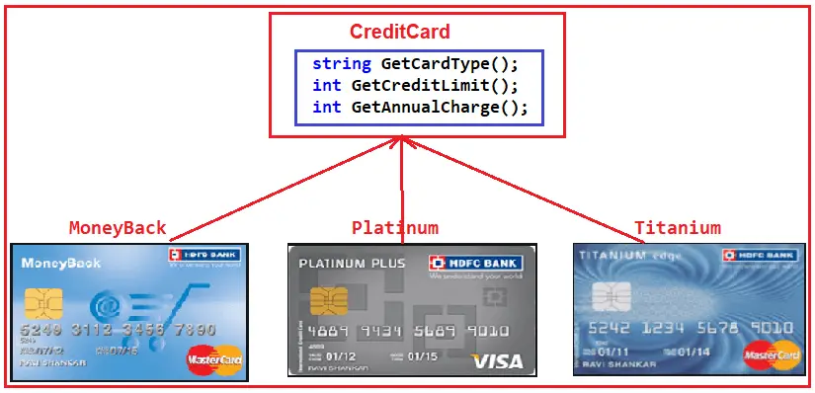
Factory Pattern
Please have a look at the following diagram. As you can see, we have three credit card classes, i.e., MoneyBack, Titanium, and Platinum. These three classes are the subclasses of the CreditCard superclass or, you can say, super interface. The CreditCard superclass or super interface has three methods, i.e., GetCardType, GetCreditLimit, and GetAnnualCharge. The subclasses, i.e., MoneyBack, Titanium, and Platinum, have implemented the above three methods of the CreditCard.

Slide 26
Factory Pattern
namespace FactoryDesignPattern
{
public interface CreditCard
{
string GetCardType();
int GetCreditLimit();
int GetAnnualCharge();
}
}

Slide 27
Factory Pattern
namespace FactoryDesignPattern
{
public interface ICreditCard
{
string GetCardType();
int GetCreditLimit();
int GetAnnualCharge();
}
}

Slide 28
Factory Pattern
namespace FactoryDesignPattern
{
class MoneyBack : ICreditCard
{
public string GetCardType()
{
return "MoneyBack";
}
public int GetCreditLimit()
{
return 15000;
}
public int GetAnnualCharge()
{
return 500;
}
}
}

Slide 29
Factory Pattern
namespace FactoryDesignPattern
{
public class Titanium : ICreditCard
{
public string GetCardType()
{
return "Titanium Edge";
}
public int GetCreditLimit()
{
return 25000;
}
public int GetAnnualCharge()
{
return 1500;
}
}
}

Slide 30
Factory Pattern
using System;
namespace FactoryDesignPattern
{
class Program
{
static void Main(string[] args)
{
//Generally we will get the Card Type from UI.
//Here we are hardcoded the card type
string cardType = "MoneyBack";
CreditCard cardDetails = null;
//Based of the CreditCard Type we are creating the
//appropriate type instance using if else condition
if (cardType == "MoneyBack")
{
cardDetails = new MoneyBack();
}
else if (cardType == "Titanium")
{
cardDetails = new Titanium();
}

Slide 31
Factory Pattern
else if (cardType == "Platinum")
{
cardDetails = new Platinum();
}
if (cardDetails != null)
{
Console.WriteLine("CardType : " + cardDetails.GetCardType());
Console.WriteLine("CreditLimit : " + cardDetails.GetCreditLimit());
Console.WriteLine("AnnualCharge :" + cardDetails.GetAnnualCharge());
}
else
{
Console.Write("Invalid Card Type");
}
Console.ReadLine();
}
}
}

Slide 32
Factory pattern offers an approach to code for interface rather than implementation.
Factory pattern removes the instantiation of actual implementation classes from client code, making it more robust, less coupled and easy to extend. For example, we can easily change class implementation because client program is unaware of it.
Factory pattern also provides abstraction between implementation and client classes through inheritance.
Benefits of Factory Pattern

Slide 33
Abstract Factory Pattern

Slide 34
The Abstract Factory design pattern provides an interface for creating families of related or dependent objects without specifying their concrete classes.
According to the Gang of Four Definition, The Abstract Factory Design Pattern provides a way to encapsulate a group of factories with a common theme without specifying their concrete classes.
Abstract means hiding some information, factory means which produces the products, and pattern means a design. So, the Abstract Factory Pattern is a software design pattern that provides a way to encapsulate a group of individual factories that have a common theme.
Abstract Factory Pattern

Slide 35
Abstract Factory Pattern
namespace AbstractFactoryDesignPattern
{
// The AbstractProductA interface
// Each distinct product of the Bike product family should have a base interface.
// All variants of Bike products must implement this IBike interface.
public interface IBike
{
void GetDetails();
}
}
namespace AbstractFactoryDesignPattern
{
// The 'AbstractProductB' interface
// Each distinct product of the Car product family should have a base interface.
// All variants of the Car products must implement this ICar interface.
public interface ICar
{
void GetDetails();
}
}

Slide 36
Abstract Factory Pattern
using System;
namespace AbstractFactoryDesignPattern
{
// The ProductB1 class
// Concrete Products are going to be created by corresponding Concrete Factories.
// The following SportsBike Product Belongs to the Bike product family
public class SportsBike : IBike
{
public void GetDetails()
{
Console.WriteLine("Fetching SportsBike Details..");
}
}
}
using System;
namespace AbstractFactoryDesignPattern
{
// The ProductA1 class
// Concrete Products are going to be created by corresponding Concrete Factories.
// The following RegularBike Product Belongs to the Bike product family
public class RegularBike : IBike
{
public void GetDetails()
{
Console.WriteLine("Fetching RegularBike Details..");
}
}
}

Slide 37
Abstract Factory pattern also offers an approach to code for interface rather than implementation.
Abstract Factory pattern is “factory of factories” and can be easily extended to accommodate more products. For example, we can add another subclass ‘Dell’ and a factory ‘LaptopFactory’.
Abstract Factory pattern is robust and it eliminates conditional logic unlike Factory pattern.
Benefits of Abstract Factory Pattern

Slide 38
Builder Pattern

Slide 39
The Builder design pattern separates the construction of a complex object from its representation so that the same construction process can create different representations.
According to GOF, the Builder Design Pattern builds a complex object using many simple objects and a step-by-step approach. The Process of constructing the complex object should be generic so that the same construction process can be used to create different representations of the same complex object.
Builder Pattern

Slide 40
The Builder Design Pattern is useful in C# when you need to create an object with many optional and required fields, especially if the object’s construction process is complex or if many representations of the object are possible. The key idea is to separate the construction of a complex object from its representation, allowing the same construction process to create different representations.
The use of Builder Pattern

Slide 41
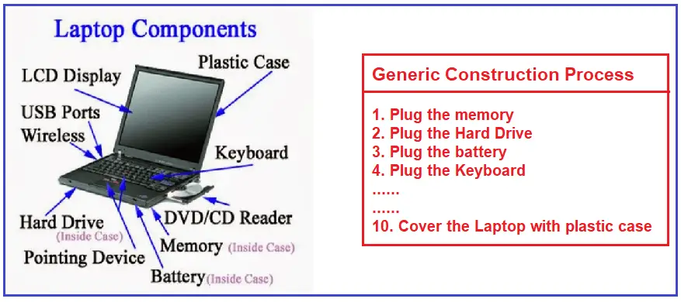
Builder Pattern Example
Real-Time Example to Understand Builder Design Pattern
Please have a look at the following diagram. Here, the Laptop is a complex object. To build a laptop, we need to use many small objects like LCD Displays, USB Ports, Wireless, Hard Drives, Pointing Devices, Battery, Memory, DVD/CD Reader, Keyboard, Plastic Case, etc. So, we have to assemble all these small objects to build the laptop complex objects.

Slide 42
using System;
namespace BuilderDesignPattern
{
public class Report
{
public string ReportType { get; set; }
public string ReportHeader { get; set; }
public string ReportFooter { get; set; }
public string ReportContent { get; set; }
public void DisplayReport()
{
Console.WriteLine("Report Type :" + ReportType);
Console.WriteLine("Header :" + ReportHeader);
Console.WriteLine("Content :" + ReportContent);
Console.WriteLine("Footer :" + ReportFooter);
}
}
}
Builder Pattern

Slide 43
namespace BuilderDesignPattern
{
public abstract class ReportBuilder
{
protected Report reportObject;
public abstract void SetReportType();
public abstract void SetReportHeader();
public abstract void SetReportContent();
public abstract void SetReportFooter();
public void CreateNewReport()
{
reportObject = new Report();
}
Builder Pattern
public Report GetReport()
{
return reportObject;
}
}
}

Slide 44
namespace BuilderDesignPattern
{
public class ExcelReport : ReportBuilder
{
public override void SetReportContent()
{
reportObject.ReportContent = "Excel Content Section";
}
public override void SetReportFooter()
{
reportObject.ReportFooter = "Excel Footer";
}
public override void SetReportHeader()
{
reportObject.ReportHeader = "Excel Header";
}
Builder Pattern
Create a class file named ExcelReport.cs and copy and paste the following code. This ExcelReport class implements the ReportBuilder abstract class and the four abstract methods, the blueprint for creating the report objects. This class is used to provide the blueprint for creating the Excel Report.
public override void SetReportType()
{
reportObject.ReportType = "Excel";
}
}
}

Slide 45
Builder Pattern
public class Product
{ public string PartA { get; set; }
public string PartB { get; set; }
}
public abstract class Builder
{ public abstract void BuildPartA();
public abstract void BuildPartB();
public abstract Product GetResult();
}

Slide 46
Builder Pattern
public class ConcreteBuilder : Builder
{
private readonly Product _product = new Product();
public override void BuildPartA()
{
_product.PartA = "Part A";
}
public override void BuildPartB()
{
_product.PartB = "Part B";
}

Slide 47
Builder Pattern
public override Product GetResult()
{
return _product;
}
}
public class Director
{
public void Construct(Builder builder)
{
builder.BuildPartA();
builder.BuildPartB();
}
}

Slide 48
Builder Pattern
public class Client
{
public void Main()
{
ConcreteBuilder builder = new ConcreteBuilder();
Director director = new Director();
director.Construct(builder);
Product product = builder.GetResult();
}
}

Slide 49
Prototype Pattern

Slide 50
Prototype pattern is used when the Object creation is a costly affair. Also, it requires a lot of time and resources and if you have a similar object already existing.
Therefore, this pattern provides a mechanism to copy the original object to a new object and then modify it according to our needs. Moreover, this pattern uses C# cloning to copy the object.
It would be easy to understand this pattern with an example. For example, suppose we have an Object that loads data from database.
Prototype Pattern

Slide 51
Now, we need to modify this data in our program multiple times.
Therefore, it’s not a good idea to create the Object using new keyword and load all the data again from the database.
Hence, the better approach is to clone the existing object into a new object and then do the data manipulation.
Prototype Pattern

Slide 52
Object Cloning
In C#, the Prototype pattern is implemented using the ICloneable interface. This interface defines a single method, Clone(), which returns a shallow copy of the current object. Shallow copying means that only the values of value-type fields and references to reference-type fields are copied. This means that if you have a reference-type field that points to another object, that object is not cloned.
public class Employee : ICloneable
{
public string Name { get; set; }
public int Age { get; set; }
public Department Department { get; set; }
public object Clone()
{
return MemberwiseClone();
}
}

Slide 53
Prototype Pattern
public abstract class Prototype
{
public abstract Prototype Clone();
}
public class ConcretePrototype : Prototype
{
public override Prototype Clone()
{
return (Prototype)this.MemberwiseClone();
}
}
public class Client
{
public void Operation()
{
ConcretePrototype prototype = new ConcretePrototype();
ConcretePrototype clone = (ConcretePrototype)prototype.Clone();
}
}

Slide 54
Prototype Pattern
In above example, Prototype is an abstract class that declares an interface for cloning itself. ConcretePrototype implements the Prototype interface and provides an implementation for cloning itself Client creates a new object by asking a prototype to clone itself.

Slide 55
When the classes to instantiate are specified at run-time, for example, by dynamic loading; or
To avoid building a class hierarchy of factories that parallels the class hierarchy of products; or
When instances of a class can have one of only a few different combinations of state. However, It may be more convenient to install a corresponding number of prototypes and clone them rather than instantiating the class manually each time with the appropriate state.
When to use Prototype Pattern

Slide 56
Structural Pattern

Slide 57
Structural design pattern is a blueprint of how different objects and classes are combined together to form a bigger structure for achieving multiple goals altogether.
The patterns in structural designs show how unique pieces of a system can be combined together in an extensible and flexible manner.
So, with the help structural design pattern we can target and change a specific parts of the structure without changing the entire structure.
Structural Pattern

Slide 58
Adapter Pattern
Bridge Pattern
Composite Pattern
Decorator Pattern
Facade Pattern
Proxy Pattern
Types of Structural Pattern

Slide 59
Sometimes, there could be a scenario when two objects don’t fit together, as they should in order to get the work done.
For example, this situation may arise when we try to integrate a legacy code with a new code, or when changing a 3rd party API in the code.
Obviously, this happens due to incompatible interfaces of the two objects which do not fit together.
Adapter Pattern

Slide 60
The adapter pattern can take two forms :
Inheritance or Composition form. In the first form, a “class adapter” utilizes inheritance.
The class adapter extends the adoptee class and adds the desired methods to the adapter.
These methods can be declared in an interface (i.e., the “target” interface). However, in the second form; an “object adapter” utilizes composition.
The object adapter contains an adoptee and implements the target interface to interact with the adoptee.
Adapter Pattern

Slide 61
Adapter Pattern
public interface ITarget
{
void Request();
}
public class Adaptee
{
public void SpecificRequest()
{
Console.WriteLine("Adaptee.SpecificRequest()");
}
}
public class Adapter : ITarget
{
private readonly Adaptee _adaptee;
public Adapter(Adaptee adaptee)
{
_adaptee = adaptee;
}

Slide 62
Adapter Pattern
public void Request()
{
_adaptee.SpecificRequest();
}
}
public class Client
{
public void Main()
{
Adaptee adaptee = new Adaptee();
ITarget target = new Adapter(adaptee);
target.Request();
}
}

Slide 63
The Adapter pattern should be used when:
There is an existing class, and its interface does not match the one you need.
You want to create a reusable class that co-operates with unrelated or unforeseen classes, that is, classes that don’t necessarily have compatible interfaces.
There are several existing subclasses to be used, but it’s impractical to adapt their interface by subclassing each one. An object adapter can adapt the interface of its parent class.
When to Adapter Pattern

Slide 64
The Proxy Design Pattern provides a surrogate or placeholder for another object to control access to it.
In fact, the Proxy Pattern is used to create a representative object that controls access to another object.
It may be remote, expensive to create or in need of being secured.
Proxy Pattern

Slide 65
In the Proxy Design Pattern, a client does not directly talk to the original object, it delegates calls to the proxy object which calls the methods of the original object.
Moreover, the important point is that the client does not know about the proxy. The proxy acts as an original object for the client.
But there are many variations to this approach which we will see shortly.
Proxy Pattern

Slide 66
There are three main variations of the Proxy Pattern:
A remote proxy provides a local representative for an object in a different address space.
A virtual proxy creates expensive objects on demand.
A protection proxy controls access to the original object. Protection proxies are useful when objects should have different access rights.
Proxy Pattern

Slide 67
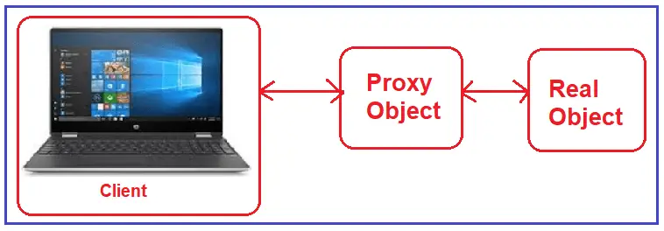
Proxy Pattern

Slide 68
Proxy Pattern
public interface ISubject
{
void Request();
}
public class RealSubject : ISubject
{
public void Request()
{
Console.WriteLine("RealSubject.Request()");
}
}
public class Proxy : ISubject
{
private readonly RealSubject _realSubject;
public Proxy(RealSubject realSubject)
{
_realSubject = realSubject;
}

Slide 69
Proxy Pattern
public void Request()
{
if (CheckAccess())
{
_realSubject.Request();
LogAccess();
}
}
private bool CheckAccess()
{
Console.WriteLine("Proxy.CheckAccess()");
return true;
}
private void LogAccess()
{
Console.WriteLine("Proxy.LogAccess()");
}
}

Slide 70
Proxy Pattern
public class Client
{
public void Main()
{
RealSubject realSubject = new RealSubject();
Proxy proxy = new Proxy(realSubject);
proxy.Request();
}
}

Slide 71
Proxy is applicable whenever there is a need for a more versatile or sophisticated reference to an object than a simple pointer.
Here are several common situations in which the Proxy pattern is applicable:
A remote proxy provides a local representative for an object in a different address space.
A virtual proxy creates expensive objects on demand.
A protection proxy controls access to the original object. Protection proxies are useful when objects should have different access rights.
When to use the Proxy Pattern

Slide 72
The Composite Pattern allows you to compose objects into a tree structure to represent the part-whole hierarchy.
It means you can create a tree of objects that is made of different parts, but that can be treated as a whole one big thing.
Composite lets clients treat individual objects and compositions of objects uniformly, that’s the intent of the Composite Pattern.
Composite Pattern

Slide 73
Base Component
Base component is the interface for all objects in the composition. Client program uses base component to work with the objects in the composition. Moreover, it can be an interface or an abstract class with some methods common to all the objects.
Leaf
Defines the behavior for the elements in the composition. It is the building block for the composition and implements base component. Although, it doesn’t have references to other Components.
Composite
It consists of leaf elements and implements the operations in base component.
Objects in the Composite Pattern

Slide 74
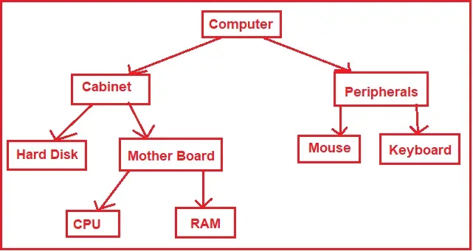
Composite Pattern

Slide 75
Composite Pattern
public abstract class Component
{
public string Name { get; set; }
public Component(string name)
{
Name = name;
}
public abstract void Add(Component component);
public abstract void Remove(Component component);
public abstract void Display(int depth);
}
public class Leaf : Component
{
public Leaf(string name) : base(name)
{
}

Slide 76
Composite Pattern
public override void Add(Component component)
{
Console.WriteLine("Cannot add to a leaf");
}
public override void Remove(Component component)
{
Console.WriteLine("Cannot remove from a leaf");
}
public override void Display(int depth)
{
Console.WriteLine(new String('-', depth) + Name);
}
}
public class Composite : Component
{
private readonly List<Component> _children = new List<Component>();

Slide 77
Composite Pattern
public Composite(string name) : base(name)
{
}
public override void Add(Component component)
{
_children.Add(component);
}
public override void Remove(Component component)
{
_children.Remove(component);
}
public override void Display(int depth)
{
Console.WriteLine(new String('-', depth) + Name);
foreach (Component component in _children)
{
component.Display(depth + 2);
}
}

Slide 78
Composite Pattern
public class Client
{
public void Main()
{
Composite root = new Composite("root");
root.Add(new Leaf("Leaf A"));
root.Add(new Leaf("Leaf B"));
Composite comp = new Composite("Composite X");
comp.Add(new Leaf("Leaf XA"));
comp.Add(new Leaf("Leaf XB"));
root.Add(comp);
root.Add(new Leaf("Leaf C"));
root.Display(1);
}
}

Slide 79
When we want to represent part-whole hierarchies of objects.
When we want clients to be able to ignore the difference between compositions of objects and individual objects. Clients will treat all objects in the composite structure uniformly.
When to Composite Pattern

Slide 80
The main function of the bridge pattern is to separate the implementation part from the abstraction part so that the abstraction and implementation of a class can vary independently.
There are in two part in Bridge Pattern:
Implementation or Body
Abstraction or Handling
Bridge Pattern

Slide 81
When both implementation and its functional abstraction needs are extended using another sub-class.
When you don't want to affect clients due to changes in implementation.
When you want to avoid permanent binding between implementation and its functional abstraction.
When to use Bridge Pattern

Slide 82
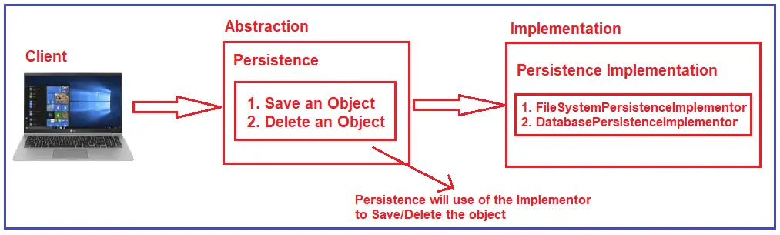
Bridge Pattern

Slide 83
Bridge Pattern
The Bridge Design Pattern, the Abstraction and Implementation should be in separate layers. Persistence is the Abstraction Layer, and Persistence Implementation is the Implementation Layer. Now, if you want to add a new implementation or if you want to remove any of the existing implementations, then it will not affect the Abstraction Layer. This is the advantage of the Bridge Design Pattern.

Slide 84
Bridge Pattern
public interface IAbstraction
{
void Operation();
}
public class Abstraction : IAbstraction
{
private readonly IImplementor _implementor;
public Abstraction(IImplementor implementor)
{
_implementor = implementor;
}
public void Operation()
{
_implementor.OperationImp();
}
}

Slide 85
public interface IImplementor
{
void OperationImp();
}
public class ConcreteImplementorA : IImplementor
{
public void OperationImp()
{
Console.WriteLine("ConcreteImplementorA.OperationImp()");
}
}
Bridge Pattern

Slide 86
public class ConcreteImplementorB : IImplementor
{
public void OperationImp()
{
Console.WriteLine("ConcreteImplementorB.OperationImp()");
}
}
Bridge Pattern

Slide 87
public class Client
{
public void Main()
{
IImplementor implementor = new ConcreteImplementorA();
IAbstraction abstraction = new Abstraction(implementor);
abstraction.Operation();
implementor = new ConcreteImplementorB();
abstraction = new Abstraction(implementor);
abstraction.Operation();
}
}
Bridge Pattern

Slide 88
In Decorator Pattern, we can add or remove object functionality without changing the function or external appearance of the object.
Therefore with help of a decorator pattern, we can add additional responsibilities to an object without changing the functionalities of the object.
Decorator Pattern

Slide 89
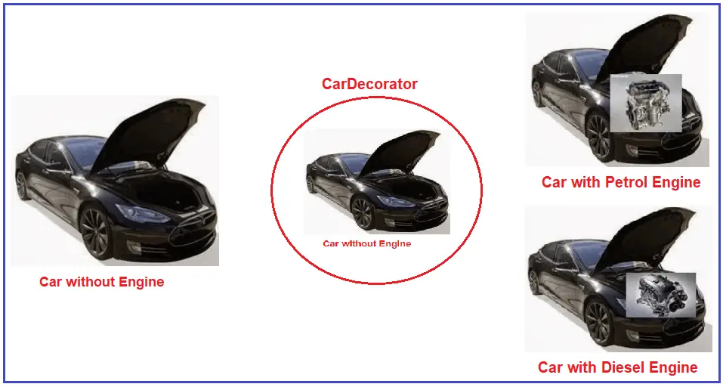
Decorator Pattern

Slide 90
It enhances the extensibility of an object, as changes are made by coding new classes.
Provides greater flexibility as compared to static inheritance.
Rather than coding all behaviour into a single object Each specific part of the functionality is simplified by coding a series of classes
When to use Decorator Pattern

Slide 91
Decorator Pattern
public abstract class Component
{
public abstract void Operation();
}
public class ConcreteComponent : Component
{
public override void Operation()
{
Console.WriteLine("ConcreteComponent.Operation()");
}
}

Slide 92
public abstract class Decorator : Component
{
protected Component component;
public void SetComponent(Component component)
{
this.component = component;
}
public override void Operation()
{
if (component != null)
{
component.Operation();
}
}
}
Decorator Pattern

Slide 93
Decorator Pattern
public class ConcreteDecoratorA : Decorator
{
public override void Operation()
{
base.Operation();
AddedBehavior();
Console.WriteLine("ConcreteDecoratorA.Operation()");
}
private void AddedBehavior()
{
}
}

Slide 94
Decorator Pattern
public class ConcreteDecoratorB : Decorator
{
public override void Operation()
{
base.Operation();
AddedBehavior();
Console.WriteLine("ConcreteDecoratorB.Operation()");
}
private void AddedBehavior()
{
}
}

Slide 95
Decorator Pattern
public class Client
{
public void Main()
{
ConcreteComponent component = new ConcreteComponent();
ConcreteDecoratorA decoratorA = new ConcreteDecoratorA();
ConcreteDecoratorB decoratorB = new ConcreteDecoratorB();
decoratorA.SetComponent(component);
decoratorB.SetComponent(decoratorA);
decoratorB.Operation();
}
}

Slide 96
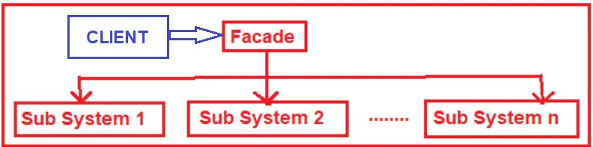
In Facade Pattern, we provide a simplified interface to a set of interfaces of a subsystem for hiding its complexity of subsystem from the client.
In simple words with the help of facade pattern, we make sub-systems easier to use by describing a higher-level interface.
Facade Pattern

Slide 97
When there are many dependencies between implementation classes of abstraction and client requirements.
When you want to have layers in your subsystems.
When you want to provide a simple interface instead of a complex subsystem.
When to use Facade Pattern

Slide 98
Facade Pattern
public interface IPizza {
void GetVegPizza();
void GetNonVegPizza();
}
public class PizzaProvider : IPizza {
public void GetNonVegPizza() {
GetNonVegToppings();
Console.WriteLine("Getting Non Veg Pizza.");
}
public void GetVegPizza() {
Console.WriteLine("Getting Veg Pizza.");
}
private void GetNonVegToppings() {
Console.WriteLine("Getting Non Veg Pizza Toppings.");
}
}

Slide 99
Facade Pattern
public interface IBread {
void GetGarlicBread();
void GetCheesyGarlicBread();
}
public class BreadProvider : IBread {
public void GetGarlicBread() {
Console.WriteLine("Getting Garlic Bread.");
}
public void GetCheesyGarlicBread() {
GetCheese();
Console.WriteLine("Getting Cheesy Garlic Bread.");
}
private void GetCheese() {
Console.WriteLine("Getting Cheese.");
}
}

Slide 100
public class RestaurantFacade {
private readonly IPizza _pizzaProvider;
private readonly IBread _breadProvider;
public RestaurantFacade() {
_pizzaProvider = new PizzaProvider();
_breadProvider = new BreadProvider();
}
public void GetNonVegPizza() {
_pizzaProvider.GetNonVegPizza();
}
public void GetVegPizza() {
_pizzaProvider.GetVegPizza();
}
Facade Pattern

Slide 101
public void GetGarlicBread() {
_breadProvider.GetGarlicBread();
}
public void GetCheesyGarlicBread() {
_breadProvider.GetCheesyGarlicBread();
}
}
Facade Pattern

Slide 102
Behavioral Pattern

Slide 103
Behavioral Design Patterns offer solution for the better interaction between objects and how to provide loose coupling and flexibility to extend easily.
Behavioral Pattern

Slide 104
Below are the some of important types of behavioral pattern..
Chain of Responsibility Pattern
Command Pattern
Interpreter Pattern
Iterator Pattern
Observer Pattern
Template Pattern
Null Object
Types of Behavioral Pattern

Slide 105
It is a data-driven behavioral pattern that turns a request into a stand-alone object known as a command.
It encapsulates all the information that is required to act i.e., it wraps the action and its required parameters together in an object.
It is used to separate the object that invokes the operation from the object that operates.
Command Pattern

Slide 106
When we need to attach operations with objects using which we can queue operations, schedule their execution, or execute them remotely.
When we wish to implement reversible operations like undo and redo operations. Since the command pattern allows us to create objects that represent the actions that are to be performed in the application, we can create a list of tasks performed (list of command objects) and can undo or redo the task just by searching and executing the undo method of the last command object from the task list.
When to use Command Pattern

Slide 107
Command Pattern
using System;
namespace CommandPattern
{
class Program
{
static void Main(string[] args)
{
// Create receiver, command, and invoker
Receiver receiver = new Receiver();
Command command = new ConcreteCommand(receiver);
Invoker invoker = new Invoker();
// Set and execute command
invoker.SetCommand(command);
invoker.ExecuteCommand();
// Wait for user
Console.ReadKey();
}
}

Slide 108
Command Pattern
// The 'Command' abstract class
abstract class Command
{
protected Receiver receiver;
public Command(Receiver receiver)
{
this.receiver = receiver;
}
public abstract void Execute();
}
// The 'ConcreteCommand' class
class ConcreteCommand : Command
{
public ConcreteCommand(Receiver receiver) : base(receiver)
{
}

Slide 109
Command Pattern
public override void Execute()
{
receiver.Action();
}
}
// The 'Receiver' class
class Receiver
{
public void Action()
{
Console.WriteLine("Called Receiver.Action()");
}
}

Slide 110
Command Pattern
// The 'Invoker' class
class Invoker
{
private Command _command;
public void SetCommand(Command command)
{
this._command = command;
}
public void ExecuteCommand()
{
_command.Execute();
}
}
}

Slide 111
It is a behavioral design pattern that allows us to pass a request between a chain of objects.
Each object in the chain contains its processing logic that performs some action and decides the next object from the chain to delegate the work.
It is used in decoupling the sender from the receiver.
Chain of Responsibility Pattern

Slide 112
When to use Chain of Responsibility Pattern
When we wish to decouple the request's sender from its receiver.
When the request provided to the application can be handled by passing it to a series of objects.
When we need to enhance the flexibility of the duties assigned to objects.
Chain of Responsibility Pattern

Slide 113
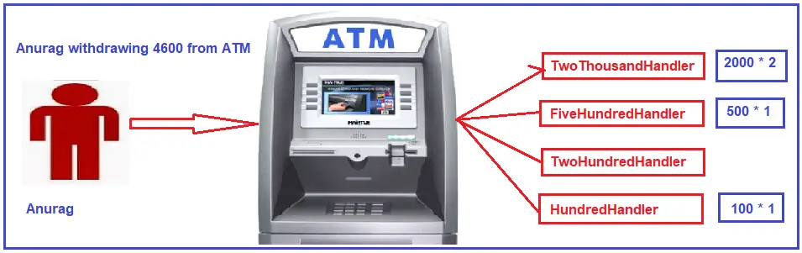
Chain of Responsibility Pattern

Slide 114
Chain of Responsibility Pattern
using System;
namespace ChainOfResponsibilityPattern
{
class Program
{
static void Main(string[] args)
{
// Create handlers
Handler handler1 = new ConcreteHandler1();
Handler handler2 = new ConcreteHandler2();
Handler handler3 = new ConcreteHandler3();
// Set the chain of responsibility
handler1.SetSuccessor(handler2);
handler2.SetSuccessor(handler3);
// Generate and process requests
int[] requests = { 2, 5, 14, 22, 18, 3, 27, 20 };
foreach (int request in requests)
{
handler1.HandleRequest(request);
}

Slide 115
Chain of Responsibility Pattern
// Wait for user
Console.ReadKey();
}
}
// The 'Handler' abstract class
abstract class Handler
{
protected Handler successor;
public void SetSuccessor(Handler successor)
{
this.successor = successor;
}
public abstract void HandleRequest(int request);
}

Slide 116
Chain of Responsibility Pattern
// The 'ConcreteHandler1' class
class ConcreteHandler1 : Handler
{
public override void HandleRequest(int request)
{
if (request >= 0 && request < 10)
{
Console.WriteLine($"{request} handled by ConcreteHandler1");
}
else if (successor != null)
{
successor.HandleRequest(request);
}
}
}

Slide 117
Chain of Responsibility Pattern
// The 'ConcreteHandler2' class
class ConcreteHandler2 : Handler
{
public override void HandleRequest(int request)
{
if (request >= 10 && request < 20)
{
Console.WriteLine($"{request} handled by ConcreteHandler2");
}
else if (successor != null)
{
successor.HandleRequest(request);
}
}
}

Slide 118
Chain of Responsibility Pattern
// The 'ConcreteHandler3' class
class ConcreteHandler3 : Handler
{
public override void HandleRequest(int request)
{
if (request >= 20 && request < 30)
{
Console.WriteLine($"{request} handled by ConcreteHandler3");
}
else if (successor != null)
{
successor.HandleRequest(request);
}
}
}
}

Slide 119
It is a behavioral pattern that is used to incorporate specialized computer language elements in programs to solve a specific set of problems.
It is used to write simple programs that understand human-like syntax.
Interpreter Pattern

Slide 120
When to use Interpreter Pattern
When we wish to provide human-like syntax to the clients and hide the application's structure complexity from the clients.
When we wish to define a grammatical representation for a domain-specific language and provide an interpreter to deal with this grammar.
Interpreter Pattern

Slide 121
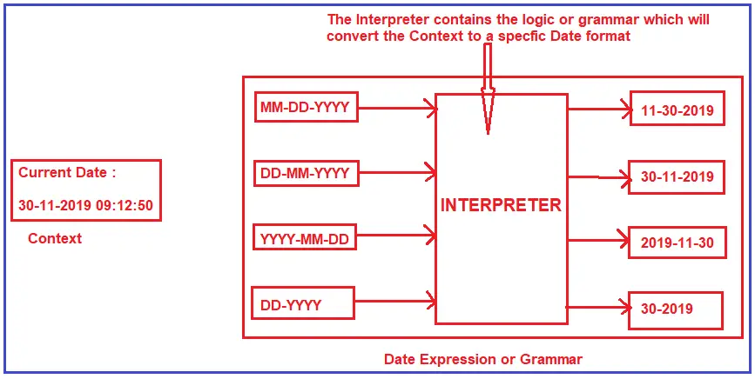
Interpreter Pattern

Slide 122
Interpreter Pattern
using System;
using System.Collections.Generic;
namespace InterpreterPattern
{
class Program
{
static void Main(string[] args)
{
Context context = new Context();
List<AbstractExpression> expressions = new List<AbstractExpression>
{
new TerminalExpression(),
new NonterminalExpression(),
new TerminalExpression(),
new TerminalExpression()
};

Slide 123
Interpreter Pattern
foreach (AbstractExpression expression in expressions)
{
expression.Interpret(context);
}
Console.ReadKey();
}
}
abstract class AbstractExpression
{
public abstract void Interpret(Context context);
}
class TerminalExpression : AbstractExpression
{
public override void Interpret(Context context)
{
Console.WriteLine("Called Terminal.Interpret()");
}
}

Slide 124
Interpreter Pattern
class NonterminalExpression : AbstractExpression
{
public override void Interpret(Context context)
{
Console.WriteLine("Called Nonterminal.Interpret()");
}
}
class Context
{
}
}

Slide 125
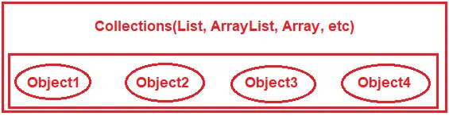
An iterator pattern is a type of behavioral pattern that is used to sequentially access the elements of a collection without exposing its underlying or internal representation.
Iterator Pattern

Slide 126
When we wish to provide a way to access and traverse the elements of a collection without revealing the internal data structures to the clients.
When we want the application to traverse different data structures.
When to use Iterator Pattern

Slide 127
Iterator Pattern
using System;
using System.Collections.Generic;
public class Aggregate
{
public Iterator CreateIterator()
{
return new ConcreteIterator(this);
}
}
public abstract class Iterator
{
public abstract object First();
public abstract object Next();
public abstract bool IsDone();
public abstract object CurrentItem();
}

Slide 128
Iterator Pattern
public class ConcreteAggregate : Aggregate
{
private List<object> _items = new List<object>();
public int Count => _items.Count;
public object this[int index]
{
get => _items[index];
set => _items.Insert(index, value);
}
private class ConcreteIterator : Iterator
{
private readonly ConcreteAggregate _aggregate;
private int _current;
public ConcreteIterator(ConcreteAggregate aggregate)
{
_aggregate = aggregate;
}

Slide 129
Iterator Pattern
public override object First()
{
_current = 0;
return _aggregate[_current];
}
public override object Next()
{
object result = null;
if (_current < _aggregate.Count - 1)
{
result = _aggregate[++_current];
}
return result;
}

Slide 130
Iterator Pattern
public override bool IsDone()
{
return _current >= _aggregate.Count;
}
public override object CurrentItem()
{
return _aggregate[_current];
}
}
}

Slide 131
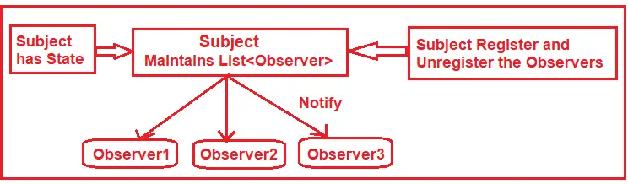
An observer pattern is a behavioral pattern that is used to monitor the state of multiple objects or classes.
It acts as a notifier of change to multiple classes. Using the observer pattern, the change in the state of an object is reflected among other objects in the application.
Observer Pattern

Slide 132
When modifications in the state of one object require a change in other objects.
When some objects must observe other objects only for a limited time or in specific cases.
When to use Observer Pattern

Slide 133
Observer Pattern
using System;
using System.Collections.Generic;
namespace ObserverPattern
{
public interface IObserver
{
void Update();
}
public interface ISubject
{
void Attach(IObserver observer);
void Detach(IObserver observer);
void Notify();
}

Slide 134
Observer Pattern
public class ConcreteSubject : ISubject
{
private readonly List<IObserver> _observers = new List<IObserver>();
private string _subjectState;
public string SubjectState
{
get => _subjectState;
set
{
_subjectState = value;
Notify();
}
}
public void Attach(IObserver observer)
{
_observers.Add(observer);
}

Slide 135
Observer Pattern
public void Detach(IObserver observer)
{
_observers.Remove(observer);
}
public void Notify()
{
foreach (var observer in _observers)
{
observer.Update();
}
}
}
public class ConcreteObserver : IObserver
{
private readonly string _name;
private readonly ConcreteSubject _subject;

Slide 136
Observer Pattern
public ConcreteObserver(string name, ConcreteSubject subject)
{
_name = name;
_subject = subject;
}
public void Update()
{
Console.WriteLine($"Observer {_name}'s new state is {_subject.SubjectState}");
}
}
public static class Program
{
public static void Main()
{
var subject = new ConcreteSubject();
var observer1 = new ConcreteObserver("1", subject);
var observer2 = new ConcreteObserver("2", subject);

Slide 137
subject.Attach(observer1);
subject.Attach(observer2);
subject.SubjectState = "State 1";
subject.SubjectState = "State 2";
subject.Detach(observer1);
subject.SubjectState = "State 3";
}
}
}
Observer Pattern

Slide 138
A template pattern is used to define the framework of an algorithm in the superclass and
lets the subclasses redefine certain steps of an algorithm without changing the overall algorithm's structure.
Template Pattern

Slide 139
When several classes contain almost identical algorithms and we need to modify all the classes when there is a change in the algorithm.
When we want to allow the clients to extend only particular steps of an algorithm, but not the whole algorithm or its structure.
When to use Template Pattern

Slide 140
A null object pattern is used to design a null object that conveys the absence of an object or acts as the default value of an object.
It is used to minimize the null-checks in an application.
Null Object Pattern

Slide 141
When we want to minimize the null-checks in an application.
When we want to perform a null-check to skip the execution or perform a default action.
When to use Null Object Pattern

Slide 142
Null Object Pattern - Example 1.
using System;
public interface IAnimal
{
void MakeSound();
}
public class Dog : IAnimal
{
public void MakeSound()
{
Console.WriteLine("Woof!");
}
}

Slide 143
public class NullAnimal : IAnimal
{
public void MakeSound()
{
// Do nothing
}
}
Null Object Pattern - Example 1.

Slide 144
Null Object Pattern - Example 1.
public class AnimalFactory
{
public static IAnimal GetAnimal(string animalType)
{
switch (animalType.ToLower())
{
case "dog":
return new Dog();
default:
return new NullAnimal();
}
}
}

Slide 145
It reduces the complexity of communication between the objects.
It provides the best object interaction principles of software development.
It reduces the coupling between the senders and the receivers and enables better communication flexibility in the application.
It is used to save the number of resources being used by an application as better object interaction leads to better task execution.
Problems Solved by Behavioral Design Patterns?

Slide 146

Check Your Understanding
What is Design Pattern?
How to implement and use Design Pattern in C#?

Slide 147

Question & Answer

Slide 148
https://www.dofactory.com/net/facade-design-pattern
https://dotnettutorials.net/lesson/decorator-design-pattern/
https://refactoring.guru/design-patterns/decorator/csharp/example
Reference Materials

Slide 149
Thavasi Narayanan S &
Logeshwaran M

